Slide 1
Will You Allow Your Thinking to
BE TRANSFORMED in order to
Engage & Equip Gen Z?
Union University
Faculty Workshop Winter 2020
Julie Powell, Ed.D.
flourishinglife.sport.blog
Department of Physical Education, Wellness & Sport

Slide 2
Equipping Strategies

Slide 3
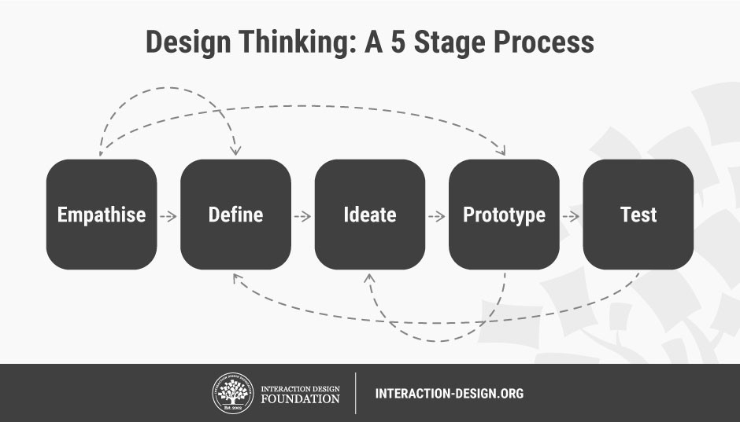
Design Thinking
Course Design Redesign Workshop
What is Design Thinking?
Group Activity
Nutrition Course
Notes:
Pose a real-life scenario to students
Have them process and think through the questions
What knowledge do they need to have to answer these questions?
Develop solutions
Backward design
Define the big why, the purpose
Why is this valuable to learn?
Why is this relevant?
What do I expect from a student who has completed one of my nutrition courses?

Slide 4
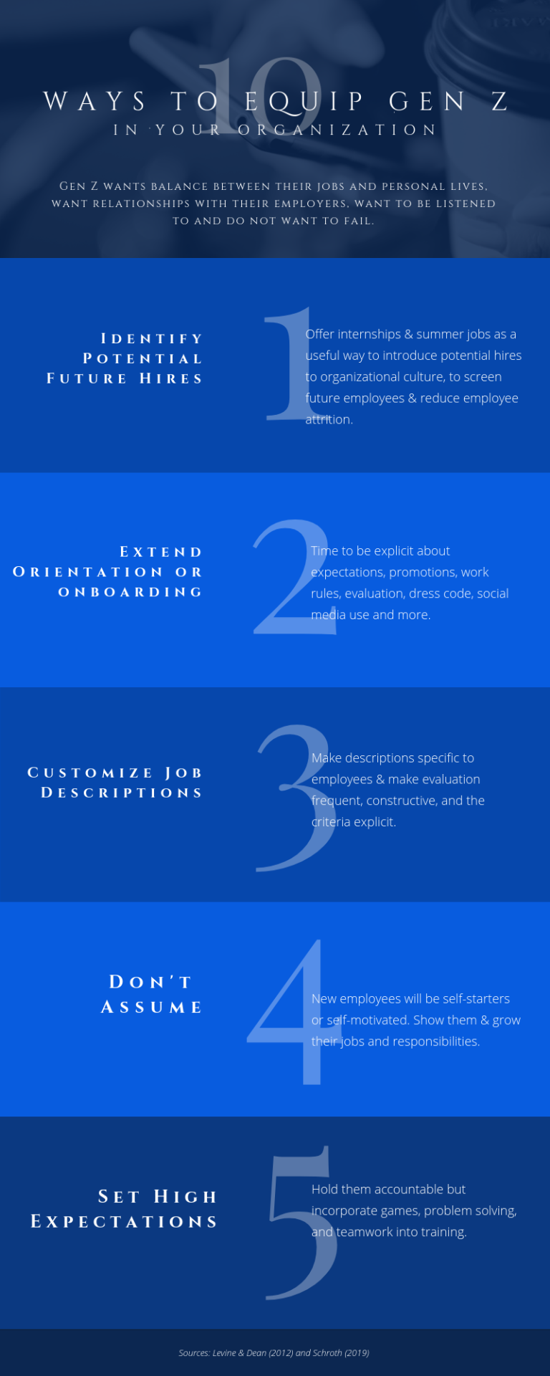
Re-Tool for Union University
Because of the challenges of an intergenerational workplace like UU, how can we alter the infographic for it to be a useful tool for new faculty?
Using the questions on the colored sheets, do any themes emerge?
Using those themes, re-write the assigned numbers.
Now, the document will say: 10 Ways to Equip Gen Z for Success at UU
Notes:
I will take the work that we produce in the workshop today and re-tool your ideas for a new 10 Ways and share later!
Can keep items either on the right or left or change all
#s 1-3 might be the most challenging to rephrase/rethink
4-10 – might just need to re-write the left side (#7 address the anxiety aspect of this generation) – free wellness center
You have 7 minutes to empathize and ideate.
Start a visible timer from a website.
https://www.timeanddate.com/timer/

Slide 5
Classroom strategies

Slide 6

Teaching Toolbox

Slide 7
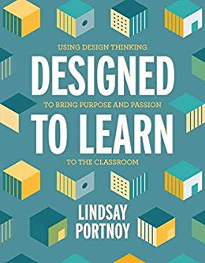
Designed to Learn: Using Design Thinking to Bring Purpose and Passion by L. Portnoy
LB3013 .P6386 2020
Notes:
Stanford design school

Slide 8

Flourishing Thinking
What are some health issues related to eating habits that are endangering us?
  Rising Obesity Rates
  Diabetes
  Sedentary Lifestyles
  Processed Foods

Slide 9
Notes:
Empathize – we have a health epidemic in our country
Define – what are the issues?
Ideate – what information do we need and how do we solve these issues?
Prototype – what education strategies work? PSAs? Books, articles? Videos? Food plates?
Test – after choosing an option, go through testing – reflect and refine
Stay tuned…offer insight…experimenting – it’s ok if I flounder – I’m still learning!

Slide 10
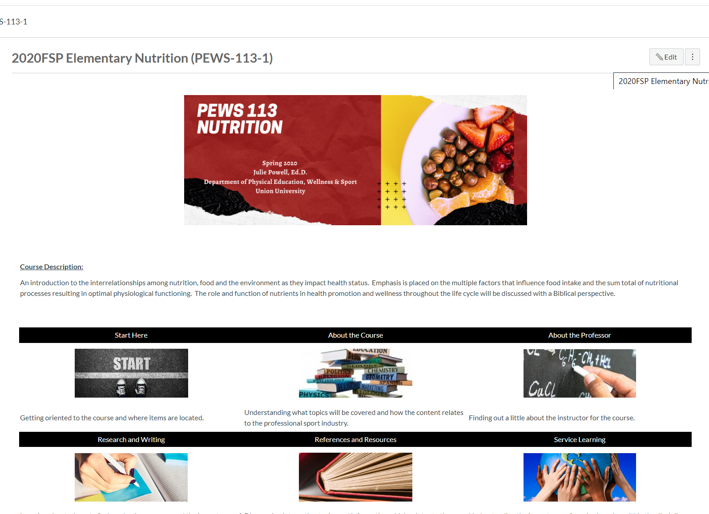
What do I expect from a student who has completed one of my nutrition courses?

Slide 11
My dream for you is to be a comfortable, confident, and exciting health professional who can intelligently engage with others about nutrition.
Notes:
Why – purpose
Relevance
Over can they remember the recommended intake in milligrams for sodium each day

Slide 12
“Gen Z is a set of behaviors and attitudes about the way the world works.
You can be born into it or you can choose to be part of it.
The Gen Z Effect is what happens when the simplicity and affordability of technology unites generations more than it divides them.”
Koulopoulos and Keldsen in The Gen Z Effect
Notes:
I want this to be a flourishing generation, so I’m choosing to be a part of Gen Z. How about you?

Slide 13
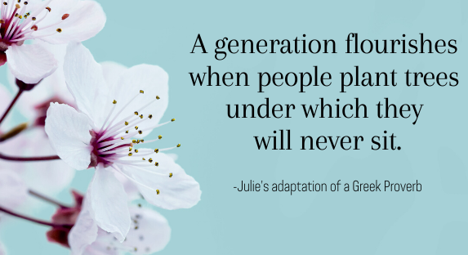

Slide 14

How will you equip and engage?
Please Share Your Success (and Failure) Stories!!!!
Notes:
Please take 1 minute to share with someone near you…or if that is uncomfortable for you, just ponder on your own.
What activity has been successful in your classes or an approach you found that resonated with the emerging adult population (Gen Z)?
What about a failure?
An activity you tried that either just completely flopped or maybe didn’t unfold like you had envisioned in your mental lesson plan.

Slide 15
References
Generational Image. Retrieved from https://www.kasasa.com/articles/generations/gen-x-gen-y-gen-z
https://platform.breakoutedu.com/
Eng, N. (2017). Teaching College: The ultimate guide to lecturing, presenting, and engaging students. ISBN-13: 978-0-9985875-1-6
Elmore, T. & McPeak. (2018, September 27). The Dark Side of Alexa and Siri. Growing Leaders [Audio Podcast]. Retrieved from Retrieved from http://itunes.apple.com
Elmore, T. (2017). Marching off the map: Inspire students to navigate a brand new world. Atlanta: Poet Gardner Publishing.
Getting to Know Gen Z Study. Barnes and Noble College.

Slide 16
References
Twenge, J.M. (2017). iGen: Why today’s super-connected kids are growing up less rebellious, more tolerant, less happy-and completely unprepared for adulthood. New York: Atria Books.
Instagrammable. (2018). Retrieved from https://www.urbandictionary.com/define.php?term=instagrammable
Peters, M. (2016, May 23). Mike Peter’s Editorial Cartoons.
The Gen Z Effect: The Six Forces Shaping the Future of Business by T. Koulopoulos & D. Keldsen
Generation Z Unfiltered by T. Elmore and A. McPeak

Slide 17
References
Generation on a Tightrope by Levine and Dean
Designed to Learn: Using Design Thinking to Bring Purpose and Passion by L. Portnoy

